Slide 1

Heart Disease Prediction Using Machine Learning
Milestone 3 Presentation – Armin Heldovac

Slide 2
Business Problem
Heart disease is a leading global cause of mortality.
Early detection reduces treatment costs and improves outcomes.
Predictive modeling identifies high-risk patients earlier.

Slide 3
Dataset Overview
Heart Disease dataset comes from Cleveland Clinic
14 clinical predictors and a binary target.
Combination of demographic, lab, ECG, and stress test data.

Slide 4
Methods
Data cleaning: imputation and encoding.
Models: Logistic Regression, Random Forest, Gradient Boosting.
Evaluation: Accuracy, Precision, Recall, F1-Score, ROC-AUC.

Slide 5
Analysis Summary
Random Forest achieved best ROC-AUC (~0.92).
Higher cholesterol and ST-depression strongly linked to disease.
Age and chest pain type showed strong predictive patterns.

Slide 6
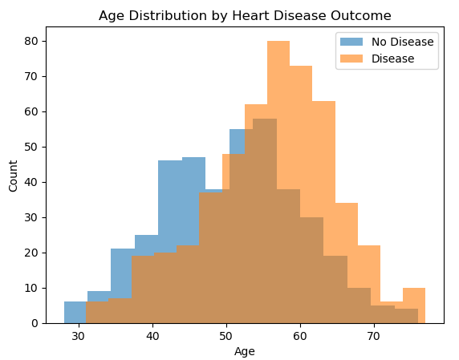
Age by Disease Graph

Slide 7
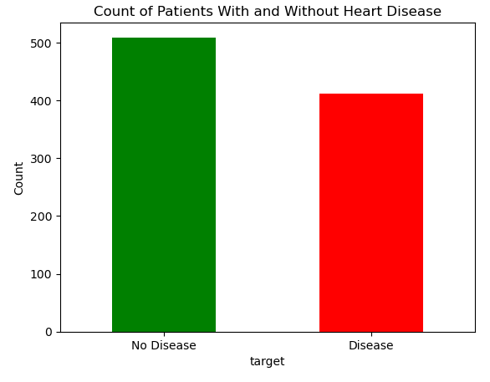
Disease vs No Disease

Slide 8
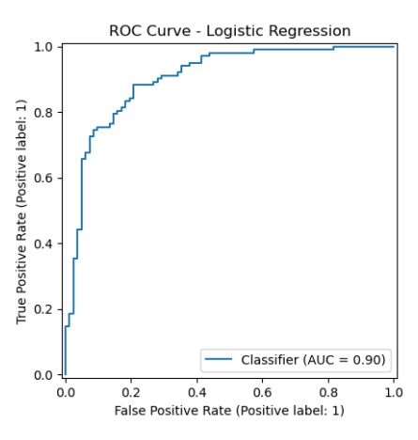
ROC Curve – Logistic Regression

Slide 9
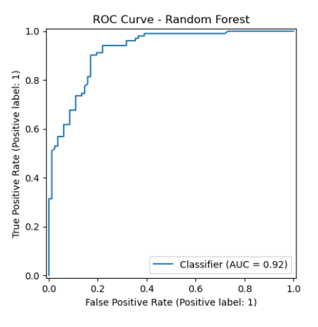
Random Forest

Slide 10
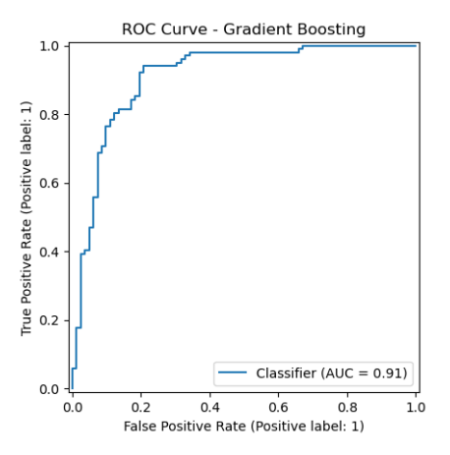
Gradient Boosting

Slide 11
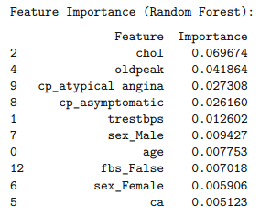
Feature Importance

Slide 12
Ethical Considerations
Data is anonymized and publicly available.
Model should not replace clinical decision making.
Avoid use in insurance or employment.
Ensure fairness across demographic groups.

Slide 13
Conclusion
Machine learning provides reliable early risk prediction.
Random Forest recommended based on performance.
Supports clinical workflows when used responsibly.

Slide 14
Questions
Did the class imbalance affect model performance?
Since the dataset is fairly balanced, no imbalance techniques were required.
How do you prevent bias in medical prediction models?
Validate across different demographic groups and avoid that features that are unfair

